Slide 1
World Café
The moderator/spokesperson of each group resents the overall results of the discussion:
  RED: discuss the key challenges in data collection process in your country
  BLUE: share the opportunities you see for your country to strengthen the national system of social protection statistics
  YELLOW: discuss the main changes on the social protection landscape in your country
  GREY: share the type of SP statistics in your work and what they are used for
Time: each group will have 5 minutes to present

Slide 2
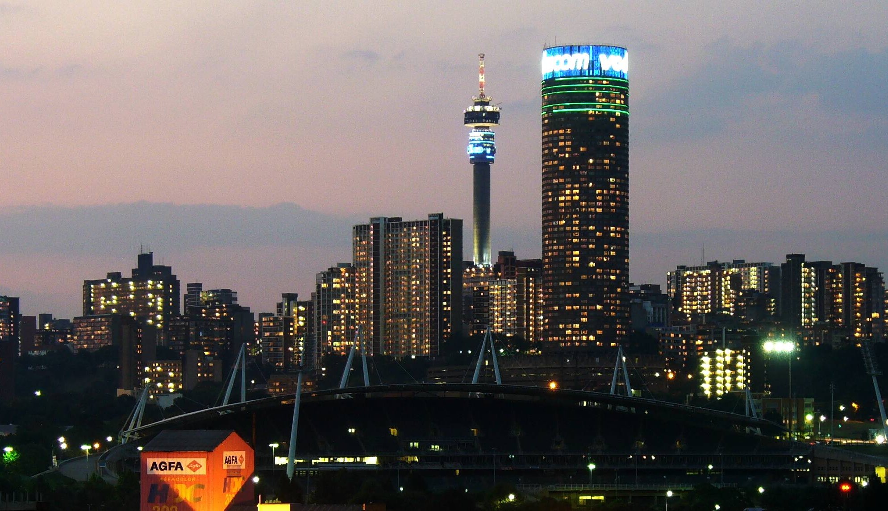
Developing National System of Social Protection Statistics (NSSPS) in South Africa
Johannesburg, 24 – 27 Feb 2025
Jasmina Papa, ILO
Zhiming Yu, ILO

Slide 3

We'd love to meet you!
Find your group – to find your teammates use a sweet tip we offered you:
  Introduce yourself (your name, what is your title/workplace)
  Tell one fun fact about yourself
  Share your expectations about this elective course
… introduce your team and share what you have learned about your teammates…
… continue meeting more colleagues throughout the course!

Slide 4
1. Social protection statistics in the context of ILO principles and definitions

Slide 5
Internationally agreed-upon core principles in the ILO standards
Overall
and Primary Responsibility of the State
Universality
Comprehensiveness
Adequacy
Sustainability
Progressive Realization
Non-Discrimination, Equality of Treatment and Social Inclusion
Minimum Predictable Levels of Income Replacement and Security
Diversity of Methods and Approaches
Solidarity through Collective Financing
Systemic Coherence and Coordination with other Public Policies and Services
Entitlement Guaranteed by Law
Horizontal and Vertical Dimensions
Transparent, Sound and Participative Management
Periodic Adjustments
Complaint and Appeals Mechanisms

Slide 6
Principles, Definition and Functions of Social Protection
Principles
  Universality, Adequacy, Sustainability and Solidarity
Social Protection Functions
Children and Families
Maternity
Unemployment
Accidents at Work
Disease
Health
Old Age
Disability
Survival
  Definition
  Social protection, or social security, is defined as the set of policies and programs designed to reduce and prevent poverty and vulnerability throughout the life cycle.
  Functions of Social Protection
  Social protection includes nine main areas. Social protection systems address all these policy areas through a combination of contributory (social security) and tax-financed non-contributory social assistance schemes.
+ poverty reduction, public employment programs, food and nutrition, housing supports, and other benefits/supports

Slide 7
National monitoring and evaluation systems
    Members should monitor progress in the implementation of social protection floors and in meeting the other objectives of social security extension strategies through appropriate nationally-defined mechanisms, including tripartite participation…
    Members should regularly collect, compile, analyze and publish an appropriate set of social security data, statistics and indicators, disaggregated in particular by gender.
    R202 - Recommendation on Social Protection Floors, 2012

Slide 8



Relevance of the minimum parameters for national systems of social protection statistics
Key component of national strategies for the development of social protection systems
Enable informed, evidence-based decision-making in the design and implementation of policies and programs
They feed the public debate to strengthen, broaden, and increase the coverage and effectiveness of social protection systems

Slide 9
The ILO's role in monitoring at global and country levels
For decades, the ILO has supported its member states in the collection, compilation and analysis of social protection statistics, including through the ILO Social Security Survey (ILO/SSI). The information is compiled in the
ILO's Global Social Protection Database
and complemented by other sources.
At the global level
  Database and the ILO World Social Protection Report, including SDG 1.3.1.
At the country level
Supporting Members to develop national systems of social protection statistics to monitor basic and extended sets of indicators, publish results related to coverage, gaps, adequacy and financing analyses.

Slide 10
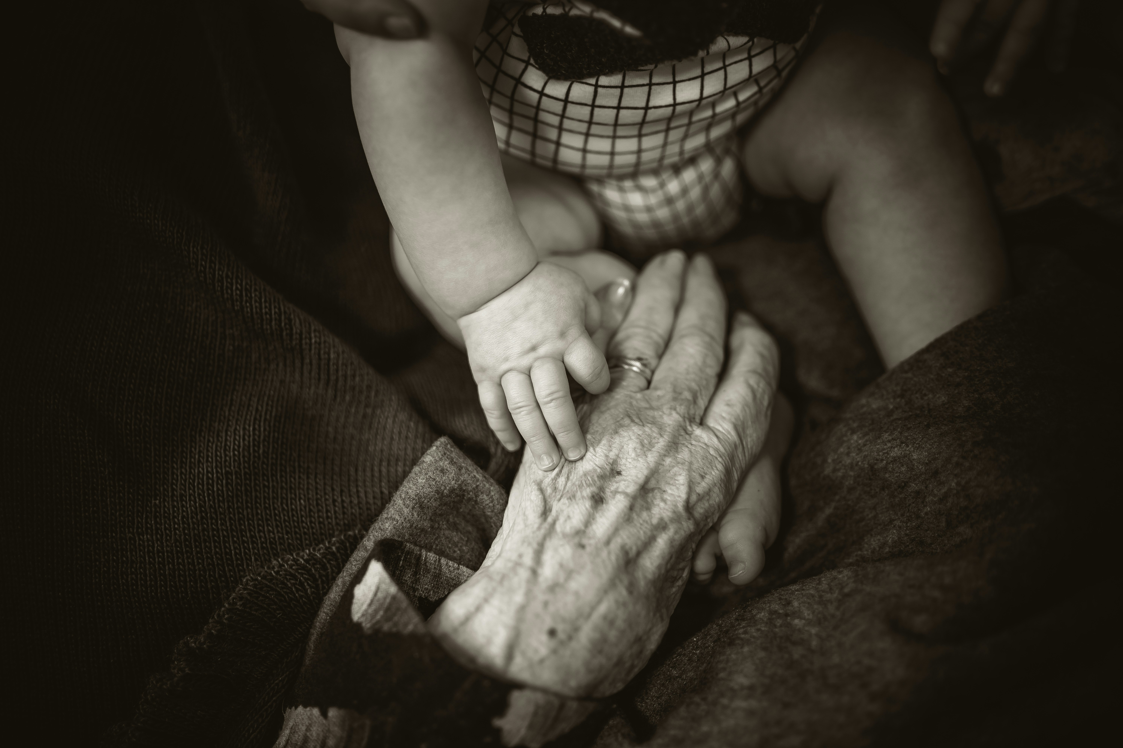
Social protection definition and functions
Social protection, or social security, is a human right and is defined as the set of policies and programmes designed to reduce and prevent poverty, vulnerability and social exclusion throughout the life cycle.
Social protection can be provided in cash or in-kind, through non-contributory schemes, providing universal, categorical, or poverty-targeted benefits such as social assistance or contributory schemes, commonly social insurance.

Slide 11
Arising out of nine branches of social security (in accordance with the scope of ILO Convention No.102), the functions are:
1. Protection in old age, including income support and long-term care;
2. Protection in disability, including income support but also medical care, rehabilitation and long-term care - income support invalidity benefit;
3. Protection of survivors in case of death of a family member (“breadwinner”);
4. Income support in the form of cash sickness benefits;
5. Protection in maternity, including medical care and income support maternity benefit;
6. Protection in “responsibility for the maintenance of children”, including the provision in kind to, or in respect of, children, of “food, clothing, housing, holidays or domestic help” and of cash income support family benefits;
7. Protection in unemployment, including income support in the form of unemployment benefits, and also other labour market policies promoting employment – income support benefits;
8. Protection in case of employment injury: medical care, rehabilitation and income support in the form of sickness, invalidity or survivors’ benefit.
9. Healthcare/ Medical care.

Slide 12
Additional functions falling under the extended definition of Social Security (Social Protection):
10. General protection against poverty and social exclusion through social assistance that provides protection to all residents without sufficient other means of income from work and not covered (or not covered sufficiently) by social security branches listed above;
11. Housing, any benefits provided in order to directly help a household meet the costs of housing;
12. Benefits in cash or in-kind providing for the basic education of children;
13. Social works services;
14. Public works programmes;
15. Food and nutrition function: benefits providing food to specific group(s) of the population to help meet a nutritionally adequate diet;
16. Other income support/assistance (not elsewhere classified).

Slide 13


Life-cycle approach of the ILO
C130
Medical care
C128
Death
C128
Disability
Sickness
C130
Lifecycle Risks
C183
Maternity
Unemployment
C168
Old-age
C128
C183
Children
Work Injury
C121
Convention No. 102 covers all 9 contingencies

Slide 14
Two dimensions of social protection
Level of protection
  For a long time, social protection was contributory and mainly adapted to the formal sector
  The assumption – that the informal sector would progressively shrink and come under social protection coverage – did not happen
???
Poor
Rest of informal sector
Formal sector
POPULATION

Slide 15
Two dimensions of social protection
Level of protection
  In many countries, formal sector workers have access to social protection
  And some programmes target the poorest, leaving the rest of the informal sector uncovered.
  Existing universal schemes
???
Poor
Rest of informal sector
Formal sector
POPULATION

Slide 16
Two dimensions of social protection
Level of protection
  Discussion on social protection in ILC 2001 led to a new consensus: the priority must be given to the extension of coverage, exploring strategies like adapted social insurance, and social assistance.
Poor
Rest of informal sector
Formal sector
POPULATION

Slide 17
Social protection floors
  All residents should enjoy at least a minimum level of social protection
  Member states of the ILO should establish SPFs as a fundamental element of their social protection systems
Level of protection
Nationally defined SPF
Poor
Rest of informal sector
Formal sector
POPULATION

Slide 18
Social protection floors
Level of protection
  Based on this floor, extend social protection to provide progressively higher levels of SP benefits to more people
Nationally defined SPF
Poor
Rest of informal sector
Formal sector
POPULATION

Slide 19


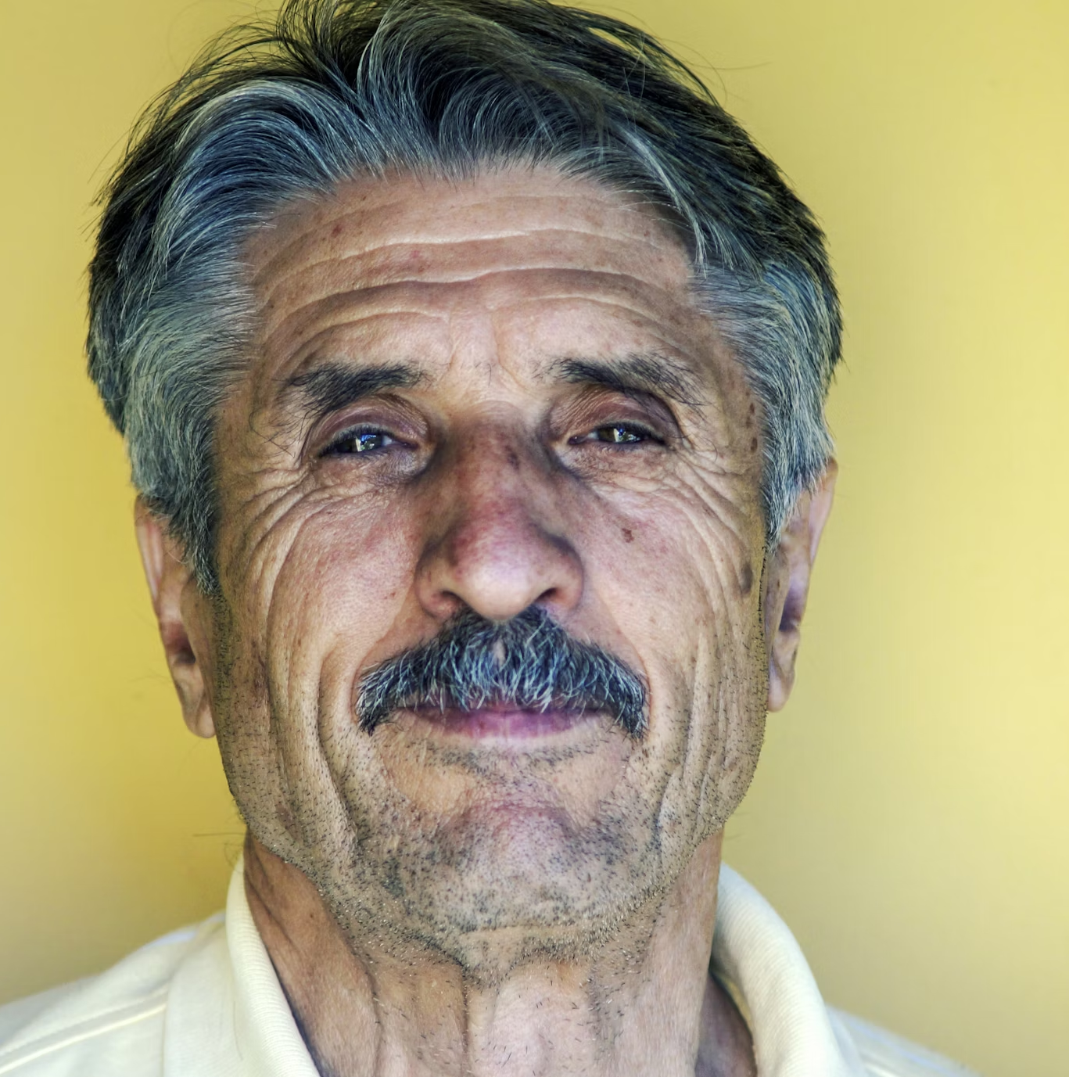
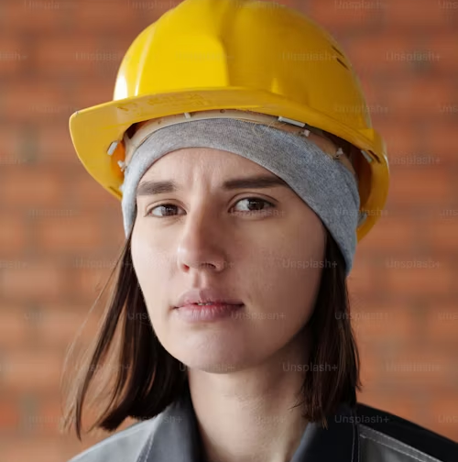
Social protection floors – Four basic guarantees
❶
❸
All persons in active age who cannot earn sufficient income, enjoy basic income security, particularly in cases of sickness, unemployment, maternity, disability
All residents have access to essential health care, including maternity care
❷
❹
All children enjoy basic income security, providing access to nutrition, education, care, and any other necessary goods and services
All older persons have basic income security

Slide 20



Horizontal Gaps
Social protection for children
Infants
School age children
Social protection for people of working-age
Public sector
Formal Private Sector
Informal Private Sector
Military Forces
Migrant workers
Pensions and care for older persons
Public Sector
Formal Private Sector
Veteran Pensioners
Uncovered

Slide 21


Public sector
Military Forces
Social protection for children
Infants
School age children
Public sector
Veteran Pensioners
Informal Private Sector
School-age children
Infants
Formal Private Sector
Formal Private sector
Poverty Threshold
Social protection for people of working-age
Public sector
Formal Private Sector
Informal Private Sector
Military Forces
Unemployed
Pensions and care for older persons
Public Sector
Formal Private Sector
Veteran Pensioners
Uncovered

Slide 22
Vertical Gaps
Social protection for children
Infants
School age children
Infants
School-age children
Poverty Threshold
Formal Private Sector
Informal Private Sector
Social protection for people of working-age
Public sector
Formal Private Sector
Informal Private Sector
Military Forces
Unemployed
Pensions and care for older persons
Public Sector
Formal Private Sector
Veteran Pensioners
Uncovered

Slide 23
Public sector
Military Forces
Social protection for children
Infants
School age children
Public sector
Veteran Pensioners
Informal Private Sector
Infants
Formal Private Sector
Formal Private sector
Poverty Threshold
School-age children
Social protection for people of working-age
Public sector
Formal Private Sector
Informal Private Sector
Military Forces
Unemployed
Pensions and care for older persons
Public Sector
Formal Private Sector
Veteran Pensioners
Uncovered
Average benefit level
Income security for all?

Slide 24
Discussion
What is the poverty threshold / National Poverty Line in South Africa?
Who defines it and how it is defined?

Slide 25
2. What are national systems of social protection statistics (NSSPS)?

Slide 26
National Systems of Social Protection Statistics (NSSPS)
Institutional Arrangement
  Institutional mechanisms that effectively articulate national rules and regulations on social protection and statistics.
Social Protection Institutions
Other public institutions
  Data collection and integration, including indicators that combine data from different sources, generating new information and allowing a global view of the social protection system.
Body of Social Protection Indicators and Statistics
Other interested parties
  Involves social protection institutions, other public institutions, stakeholders, and data sources from different social protection programs

Slide 27
NSSPS and key institutional actors
i
The main institutional actors that should participate in the NSSPS can be organized into five main categories:
  Ministries and institutions
  Responsible for planning and designing social protection policies (contributory and non-contributory programs and health care).
  Ministries and institutions
  Responsible for managing public finances and the state budget, which have a comprehensive and detailed view of social protection spending.
  National statistical institute
  Responsible for population censuses, household surveys and general statistics.
  Public, private, and international institutions
  administering social protection programs.
  Tripartite representation
  in social security institutions.
i
Social partners, representatives of informal workers, organizations representing beneficiaries and vulnerable groups, as well as other civil society organizations can also participate in the NSSPS, for example by taking on a consultative role.

Slide 28
Actors participating in NSSPS - an example
Social protection statistics
Ministry of Social Development
National Statistics Institute
Public sector Pension Fund(s)
(public sector schemes)
Ministry of Labour and Social Security
National Social Security Institute (private sector schemes)
National Agency for Social Assistance
Non-contributory schemes
Inter-institutional Working Group on Social Protection Statistics
Contributory schemes
Source: based on 2018 Mozambique Estatistical Bulletin on Social Protection

Slide 29
NSSPS enabling environment
Institutional capacity for data collection and analysis with the participation of technical resources with good knowledge and access to data.
Clear rules and regulations.
Harmonization of concepts and methodologies for data classification, collection, processing and analysis.
Cross-sector coordination and links with other official statistics producing agencies, such as labor, economic, education, planning, financial and fiscal statistics, as well as with national statistical offices.
Meticulous planning and implementation
Solid and reliable information and communication systems (ICT).
Political support at the highest level

Slide 30

Benefits of institutionalizing the NSSPS
Provides a panorama of the social protection system through an integrated product at the national level.
Supports informed decision making for policy design, implementation, monitoring, evaluation, and impact assessment.
  Offers an integrated approach and creates synergies between policy areas and institutions in other fields, such as employment, finance, health, education, and vocational training.
Allows regular and predictable data update and ensures the sustainability of institutional processes.
Enables a fast and efficient response in crisis situations (pandemics or catastrophes).
Contributes to the transparency of public management

Slide 31
In particular, NSSPS helps countries to ...
Understand/evaluate the current situation
Mapping the social protection system: what is in place?
What are their needs that are currently not or insufficiently covered?
What are the gaps?
Efficiency/effectiveness of existing schemes And need for new program development
Informing policies
On relevant options to fill the gaps (extending coverage; increasing benefits; reducing current limitations; promoting greater integration
Simulate effects/impacts and estimate cost
Of possible reforms of existing programs or the development of new programs
Regularly control...
The extent of coverage
The effects of social protection, e.g., poverty, inequality reduction; income maintenance, etc. (in line with program objectives)

Slide 32
Also... the development of the NSSPS
Strengthen public trust in social protection systems
The ability of social protection institutions to regularly release and make available statistics, and demonstrate who benefits from public resources allocated to programs, is essential to promote broader understanding and engage society.
Robust statistical systems are also essential for planning purposes
Actuarial projections, for example, are essential for assessing the financial situation of social security schemes. The quality of the estimates produced by the actuarial models depends on the quality of the data input, and this requires comprehensive management and information systems.
The scarcity of data on coverage gaps prevents identifying which groups are being left behind, as well as the funding needs associated with such gaps
Conversely, its absence could jeopardize the achievement of the 2030 Agenda

Slide 33
Uses of data - examples
1. Drafting up and monitoring national plans or strategies
Goal: Universal social protection by 2030
Policies: Increasing coverage by combining contributory and non-contributory systems
Monitoring with the indicator: % of the total population covered by a social protection system or floor
Current coverage, Target coverage
Progressive expansion of social protection schemes
Monitoring supported by data and statistics

Slide 34

Social security is one of the rights enshrined in the Constitution of the Republic of Cabo Verde, and it is the responsibility of the State, through the national social protection policy, to promote the development of a culture of national and group solidarity, ensure the basic rights of citizens, and guarantee equal opportunities for all. […]
According to the National Social Protection Bulletin, in 2020, about 286,006 people, or 51 out of every 100, received at least one monetary social protection benefit from contributory or non-contributory schemes. The vast majority (88%) of covered individuals are in the non-contributory scheme, and women make up the majority (54.6%) of the covered population.[…]
52.7% of people with severe disabilities receive disability benefits, 7.3% of the unemployed receive unemployment benefits, and about 69.8% of the elderly population aged 60 or older receive at least one monetary benefit, whether for old age, disability, or survivor benefits. […]

Slide 35
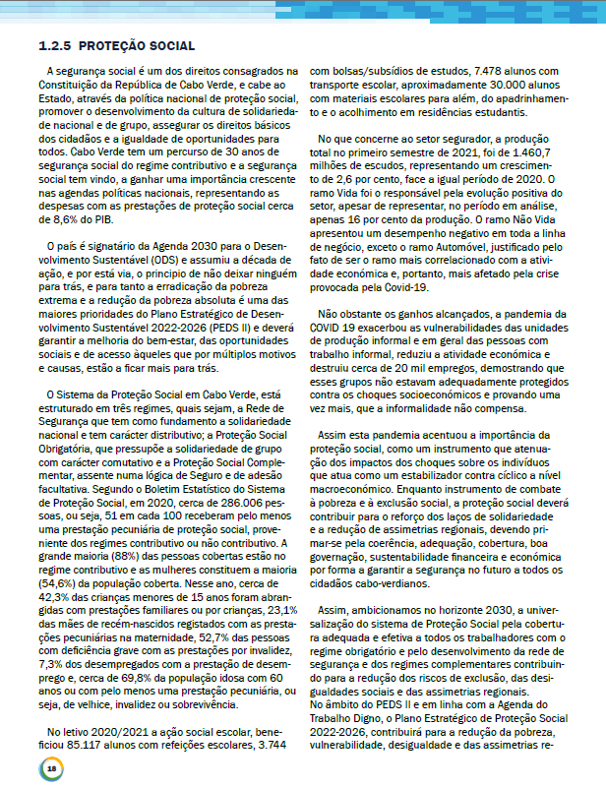
Within the framework of PEDS II and in line with the Decent Work Agenda, the Strategic Social Protection Plan 2022-2026 will contribute to reducing poverty, vulnerability, inequality, and regional disparities, aiming for the universalisation of social protection coverage. This aligns with Cabo Verde Ambition 2030, promoting decent work while strengthening social and political stability in the country. Thus, by 2026, PEDS II aims to:
Increase Social Pension coverage to 56.8% for elderly people and persons with disabilities in groups I, II, and III of the Single Social Registry;
Increase the proportion of employed individuals covered by the Contributory Scheme to 66% and achieve a 90% collection rate and user satisfaction level;
Raise School Canteen coverage to 95% and increase Scholarship coverage to 40% for young people aged 18 to 24 attending higher education, regardless of their municipality of residence.
[…]

Slide 36
2. Contributory System: Actuarial Evaluations and Pension Reforms
Increase in retirement age?
Increase in contributions?
Increase in contribution period?
Increase in pension/benefit level?
Include more healthcare services? &
Maintain contribution rates (e.g. Cyprus)?
Decrease in retirement age?
Example:
Uruguay, from 65 years to 58 years for unemployed individuals without coverage from another benefit.
3. Non-Contributory System: Adjustments or New Assistance Programs
Target population? Criteria? Evolution?
What is the benefit level?
Duration and payment method?
How much does the program cost?
What is the implementation pace?
Expected coverage rate?
Example:
Increase Social Pension coverage to 56.8% for elderly people and persons with disabilities in groups I, II, and III of the Single Social Registry;

Slide 37
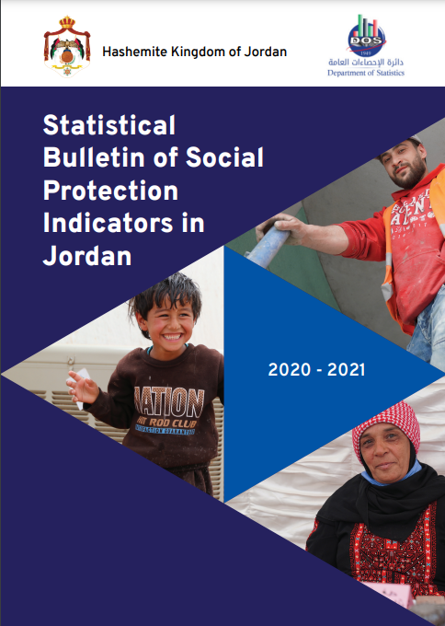





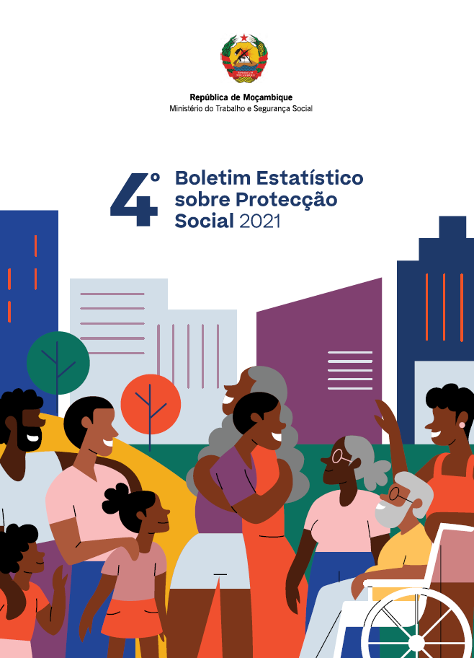
Examples of National Social Protection Bulletins

Slide 38
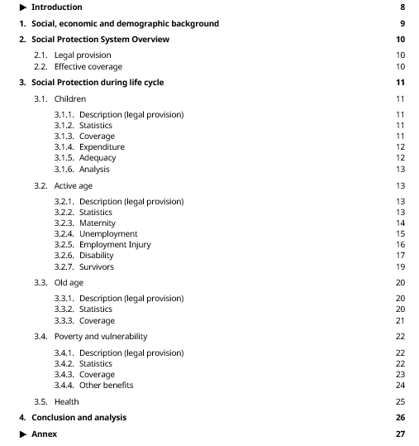
By administration OR life-cycle approach
Introduction
Background information
  Background and context data e.g. demographic, socio-economic
The SP system in the country
  Descriptions of the national SP system, strategy, etc
  Schemes and benefits, legal basis and recent reforms
  Any other issue or thematic e.g. extension to informal workers
Key characteristics and data of each scheme and benefit
Monitoring framework and results
  Summary of data, and aggregate levels of coverage
  Estimation of the SDG indicators and any other relevant indicators.
Annex - Data tables

Slide 39
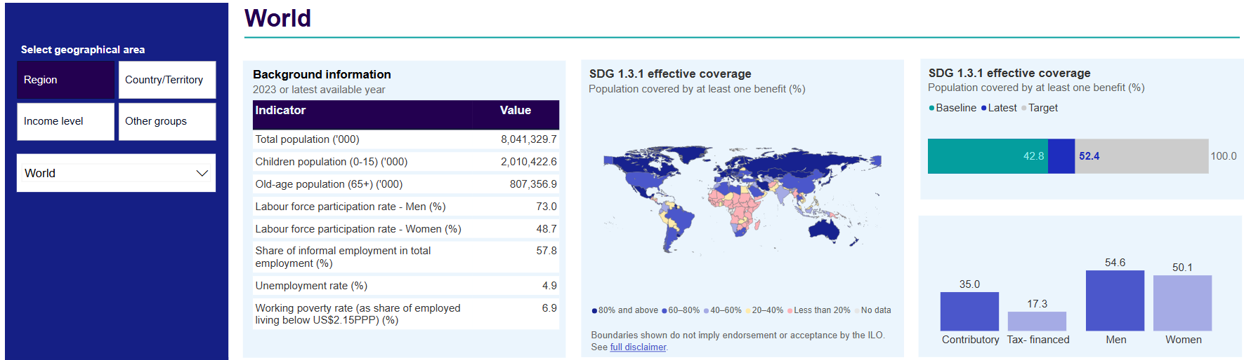
Example of international use of SP data
ILO World Social Protection Data Dashboards, available at: https://www.social-protection.org/gimi/WSPDB.action?id=19
More details tomorrow

Slide 40


However, many challenges remain:
Limited political culture regarding evidence-based decision making
Technical and methodological differences in data collection, disaggregation and processing between institutions
a
e
High informality and lack of traceability of the degree of social protection coverage (%)
Differences in the capacity and agility of national institutions to produce and make available administrative data
b
Challenges in establishing the NSSPS
f
Lack of information management systems
Lack of communication and coordination among SP institutions
c
g
Lack of leadership on of social protection statistics in the strategic planning of the ministries involved
Fragmentation of social protection systems and their databases
d
h

Slide 41


Processes: Categorization of schemes and benefits
Schemes/Programmes
Benefits features
Function
Type
Periodicity
Eligibility
C
Elderly
Means-tested
Public
Contributory
Periodic
Public
Old-age
Survivors**
Cash
NC
Non-contributory
Public
Statutory
Working age
Lump-sum
Universal
C
Public
Contributory
Sickness
Disability/Invalidity
Unemployment
Work injury
Maternity
Survivors**
ALMP
Housing**
Other social assistance**
Private
In kind
Universal - categorical
NC
Non-contributory*
Public
SP System
C
Public
Contributory
Public
NC
Non-contributory
Other criteria
Public
Non-statutory
C
Mandatory X Voluntary
Main benefit X Supplements
Conditional X Unconditional
Public
Contributory
Private
Family/Child benefits
NC
Non-contributory
Public
Healthcare benefits

Slide 42
WORLD CAFÉ

Slide 43
World Café
Find your group using the colour code on the sweets you have received:
Join your group:
  RED: discuss the key challenges in data collection process in your country
  BLUE: share the opportunities you see for your country to strengthen the national system of social protection statistics
  YELLOW: discuss the main changes on the social protection landscape in your country
  GREY: share the type of SP statistics in your work and what they are used for
Use post-its to document the main points of your discussion
Choose a moderator/spokesperson of your group
Time: you will have 15 minutes for the discussion in the groups

Slide 44
World Café
Join your second group, moving clockwise
The moderator/spokesperson remains at the table
Examine the post-its of the previous group’s discussion and think of other ideas and new contributions you can make:
  RED: discuss the key challenges in data collection process in your country
  BLUE: share the opportunities you see for your country to strengthen the national system of social protection statistics
  YELLOW: discuss the main changes on the social protection landscape in your country
  GREY: share the type of SP statistics in your work and what they are used for
Time: you will have 15 minutes for the discussion in the groups

Slide 45
World Café
Join your third group, moving clockwise
The moderator/spokesperson always remains at the table
Examine the post-its of the previous group’s discussion and think of other ideas and new contributions you can make, try to eliminate the duplicates or group them:
  RED: discuss the key challenges in data collection process in your country
  BLUE: share the opportunities you see for your country to strengthen the national system of social protection statistics
  YELLOW: discuss the main changes on the social protection landscape in your country
  GREY: share the type of SP statistics in your work and what they are used for
Time: you will have 10 minutes for the discussion in the groups

Slide 46
World Café
Join your fourth group, moving clockwise
The moderator/spokesperson always remains at the table
Examine the post-its of the previous group’s discussion and think of other ideas and new contributions you can make, try to eliminate the duplicates or group them:
  RED: discuss the key challenges in data collection process in your country
  BLUE: share the opportunities you see for your country to strengthen the national system of social protection statistics
  YELLOW: discuss the main changes on the social protection landscape in your country
  GREY: share the type of SP statistics in your work and what they are used for
Time: you will have 5 minutes for the discussion in the groups

